Slide 1

Setting Up Your Computer for Peloton-To-Google-Sheets
Basic Setup for Those Unfamiliar with Python or new to Google Developer APIs

Slide 2
Steps
Update Python
Update PIP
Set Up a Google Service Account and follow the instructions to download the JSON file
Create a Google Sheet and connect your Service Account
Edit your ‘login.csv’
Edit the script to suit your needs
Path Locations
Data YOU specifically want
If you’ve never worked with code and feel overwhelmed, don’t hesitate to reach out. I’ll customize the code for your specific needs and wants.
Keep/Remove what you don’t want
If you have a Raspberry Pi or Similar Device, edit the CRONTAB to run the script at specific times
If you plan on running the script ‘on-demand,’ utilize the CMD line to run it
(again, there’ll be screenshots later)
Ride and let your computer do the work for you ☺

Slide 3
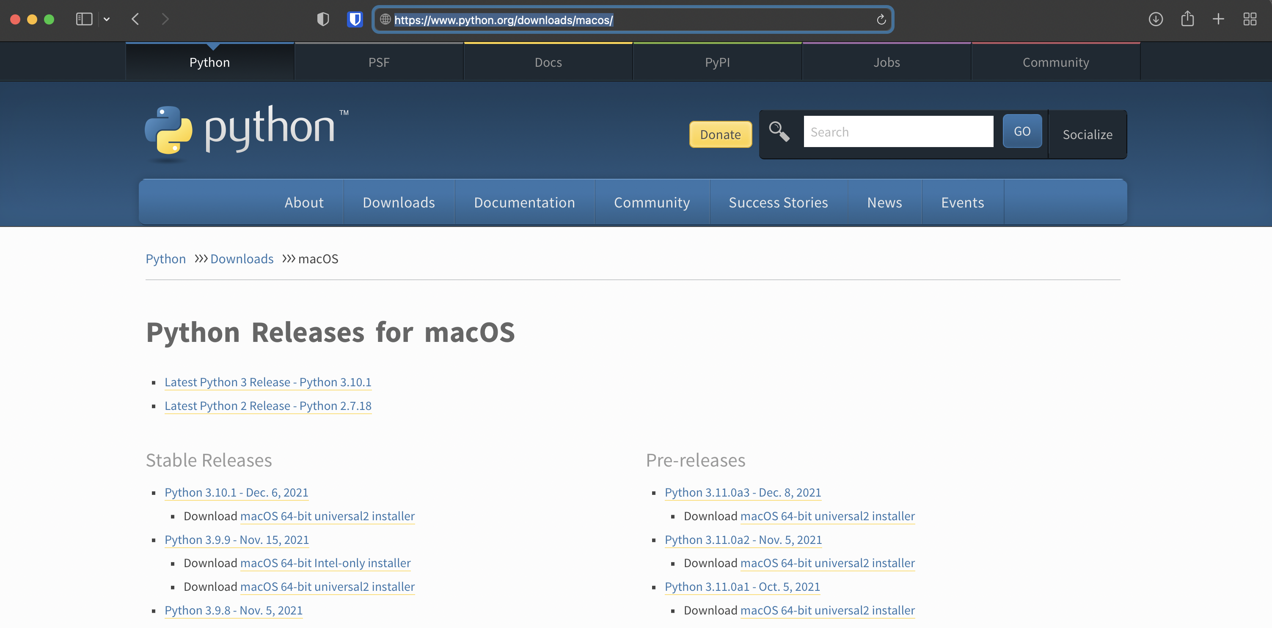
Install/Update Python on Mac
Navigate to https://Python.org/downloads/macos/
Download the latest ‘Stable Release’
Here’s a tutorial: https://www.laptopmag.com/how-to/install-python-on-macos
Click Here

Slide 4
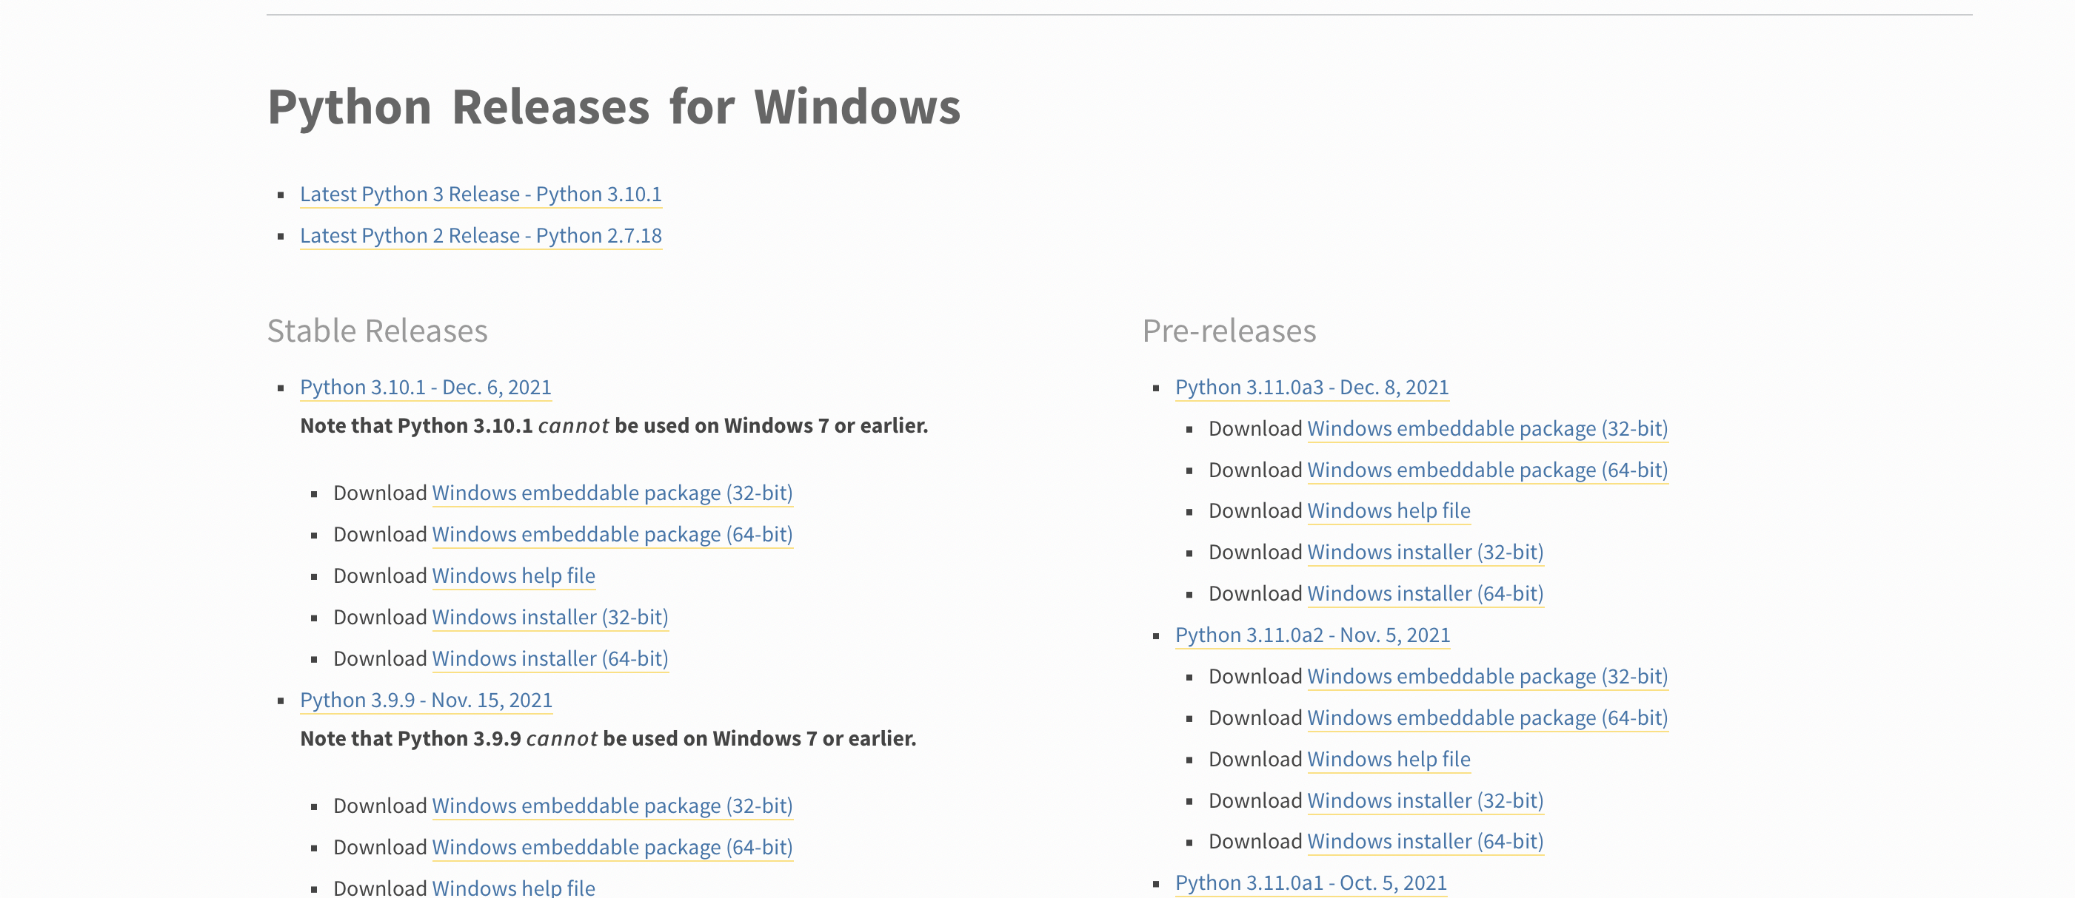
Install/Update Python on Windows
Navigate to https://www.python.org/downloads/windows/
Download the latest ‘Stable Release’
Here is a pretty decent tutorial
https://datatofish.com/install-python/
Click Here (based on your computer)

Slide 5
Update PIP on Mac
PIP should have been installed with the python download
Navigate to the ‘Terminal’
Use Spotlight and search ‘terminal’ if you are unsure where it is
Into the Terminal Type the following:
pip install --upgrade pip
If you get an error about the pip command not being found, the easiest thing to do is use your Python interpreter, so try the following:
python -m pip install --upgrade pip
Sometimes, installations will also install an alias called pip3, so you may have to try the following:
pip3 install --upgrade pip

Slide 6
Update PIP on Windows
PIP should have been installed with the python download
First, type Command Prompt in the Windows search box
Next, open the Command Prompt, and you’ll see the following screen with your user name (to avoid any permission issues, you may consider to run the Command Prompt as an administrator):
In the Command Prompt, type “cd\” to ensure that your starting point has only the drive name
Example: C:\Users\name>cd\
Press Enter, and you’ll see the drive name C:\>
Locate your Python application path, which is the folder where you originally installed Python.
Example: C:\Users\name\AppData\Local\Programs\Python\Python39
Once you retrieved the Python application path, type the following command in the Command Prompt: “cd” followed by your Python application path
Example: C:\>cd C:\Users\name\AppData\Local\Programs\Python\Python39
Press Enter, then type: python -m pip install --upgrade pip
Example: C:\Users\name\AppData\Local\Programs\Python\Python39>python -m pip install ––upgrade pip
That’s it!

Slide 7
Download the Required Dependencies
Pandas
Numpy
Seaborn
Matplotlib
Gspread
Plotly
Plotly.express
Smtplib
To install, simply type pip install followed by the dependency name into your command line (after closing it and reopening it [from the previous step])
pip install pandas
pip install numpy
pip install matplotlib
Pip install Gspread
etc
Note: This is for inexperienced users, there are other ways to install these

Slide 8
Setting Up a Google Service Account
A Google Service Account enables us to update a google sheet with our data
This is extremely helpful if you are running remotely on a schedule with a device like a Raspberry Pi
Navigate to https://cloud.google.com/iam/docs/service-accounts for the full documentation on what Service Accounts are and how they work
Create a new Google Sheet
Feel free to name it whatever, you want, but the script utilizes 5 tabs (‘Aggregate Data’, ‘Requested Workout Data’ (which is the 4 primary categories I was focused on), ‘Numerical Workout Data’, ‘Description of All Data’, and ‘Lifetime/Historical Data’)
Now to set up access to Google APIs
The API we will use is Gspread
Below is the step by step on how to set this up for use with your ‘project’
https://docs.gspread.org/en/latest/oauth2.html
The final step you will have to accomplish is step 7 (‘Move the downloaded file to ~/.config/gspread/service_account.json. Windows users should put this file to %APPDATA%\gspread\service_account.json.’)
Personally, I saved the created JSON to the same path where I am running the script from

Slide 9
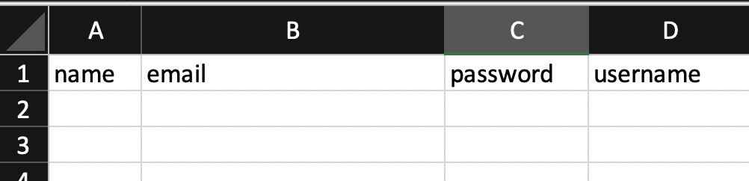
Create Your ’Login.csv’
The example can be found here
https://github.com/tychaney/Peloton-Data-to-Google-Sheets/blob/master/LoginDataEmpty.csv
This is important if you plan on having multiple users in your household like I do
Alternatively, you can hard-code your login credentials into the script itself

Slide 10
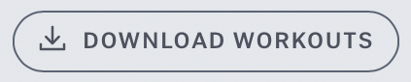
Edit the Script to Suit Your Specific Needs
The script itself can be found here
https://github.com/tychaney/Peloton-Data-to-Google-Sheets
If you plan on editing code (more than the step-by-step on the following slides), I personally recommend downloading VS Code. If all you plan on doing is this peloton script, a standard text editor will do
Some background, this script is designed for 2 riders. If you only plan on doing this tracking for yourself, you can immediately delete everything associated with ‘user_2’
Before we start with editing, there are a few links you will need to retrieve
The specific link to your Google Sheet
The specific link to YOUR workout.csv data. This can be found by logging onto your onepeloton.com
Click on ‘My Membership’ → ‘Profile’ → ‘Workouts’(At the top)
On this page, you’ll see a button that looks like this
Right Click that and select ‘Copy Link’

Slide 11
Edit the Script to Suit Your Specific Needs

